Slide 1
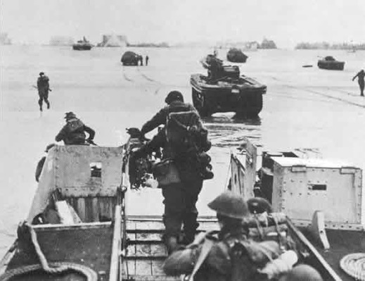
Sword beach
Ouistreham, Hermanville-sur-mer, the hillman fortress

Slide 2
Summary
Sword Beach
Map
Pegasus Bridge
Ouistreham
Philippe Kieffer and the No.4 Commando
Hermanville-sur-mer
Colleville-Montgomery
The Hillman Fortress

Slide 3
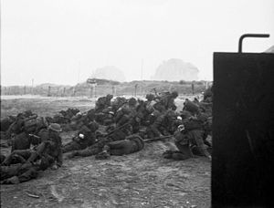
Sword beach
one of the main landing areas
8km
From ouistreham to aubin-sur-mer
Easternmost landing site

Slide 4
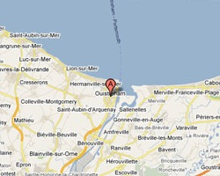
MAp

Slide 5
Pegasus Bridge
Operation Deadstick
Operation Tonga
Euston 1
One of tops-facts of the landing of Normandy

Slide 6
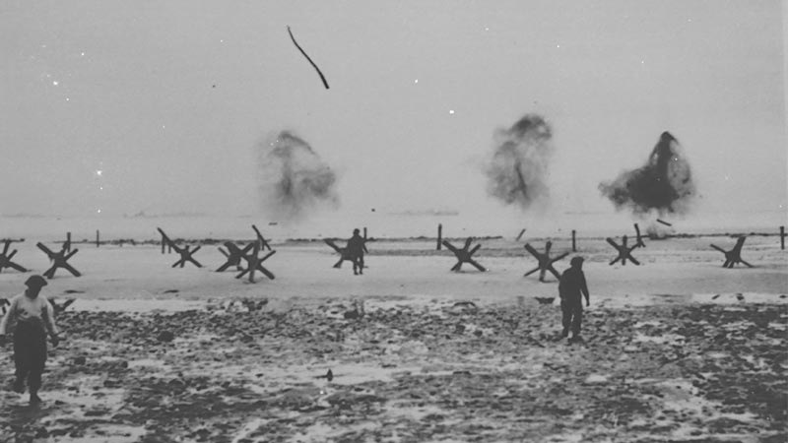
Ouistreham
1942:no-man’s-land
80 works in concretes
An observation post of artillery
Philippe Kieffer
6 June 1944
No. 4 Commando
Pegasus Bridge
No. 10 (Inter-Allied) Commando

Slide 7
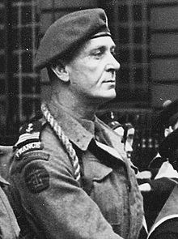
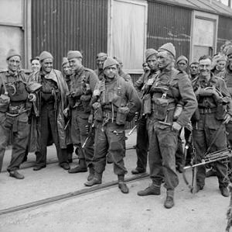
Philippe Kieffer
24 October 1899 – 20 November 1962
lieutenant
Two troops
British Army commando unit
Early in the Second World War

Slide 8
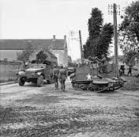
Hermanville-sur-mer
Operation Overlord
Queen Beach
South Lancashire Regiment landed on Queen White
East Yorkshire Regiment landed on Queen Red

Slide 9
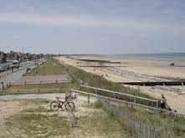
colleville-montgomery
Colleville-sur-orne
Philippe Kieffer
marshal montgomery
1946: Colleville-sur-orne became colleville-montgomery

Slide 10
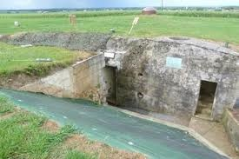
The hillman fortress
German bunker complex and command post
Near Colleville-Montgomery
British Suffolk Regiment(8th Infantry Brigade of the British 3rd Infantry Division)
Difficult to take
Sherman Fireflies
morning of 7 June
two officers and five men killed
24 wounded

