Slide 1
Shepard Fairey
War by numbers

Slide 2
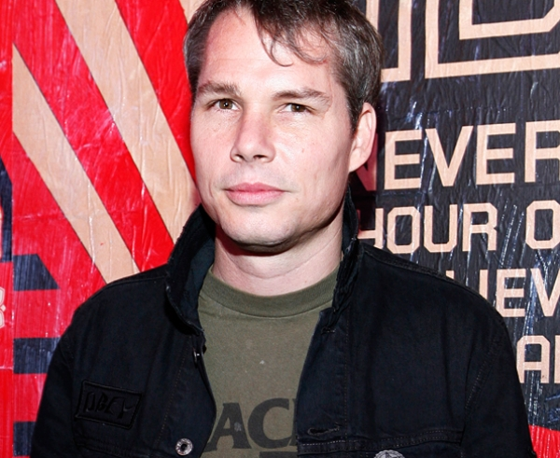
Biography
Born on february the fifteen, nineteen seventy in Charleston, in South Carolina in the United States.
Very famous graphic artist, muralist, and overall artist.
He earned his Bachelor of Fine Arts from the Rhode Island School of Design in Providence, Rhode Island in nineteen nighty two.

Slide 3
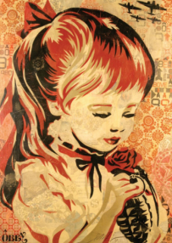
The paint
War by numbers was painting in

