Slide 1
I SHOP THERFORE I AM

Slide 2
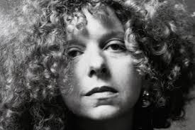
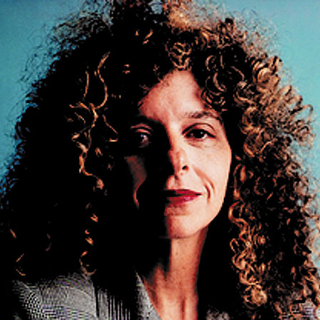
This picture was created by Barbara Kruger…
born on January 26th 1945 in Newark, in USA

Slide 3
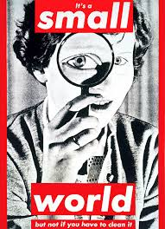
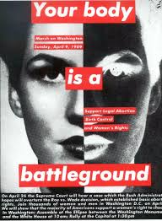
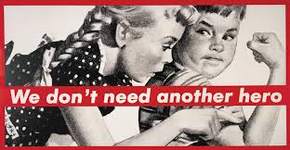
For more than twenty years the American artist Barbara Kruger explores and reveals the power of the language in the relations human as in the media…
She made famous by her photos-assemblies juxtaposing a photo, her slogans which also invade the public place…

Slide 4
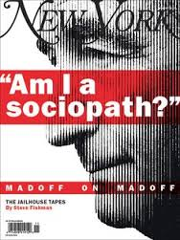
His.
The former graphic designer of the New York magazine"Miss", Barbara Kruger diverts the advertising image.

Slide 5
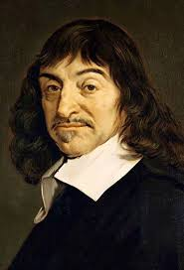
1596-1650 A mathematician, a physicist and a French philosopher
His images take for frame the consumer society as well as the minorities of all kinds subjected to the authority and to the social stereotypes.
Barbara Kruger resumed the expression " I think therfore I am " of Descartes.

Slide 6
Description of the image

Slide 7
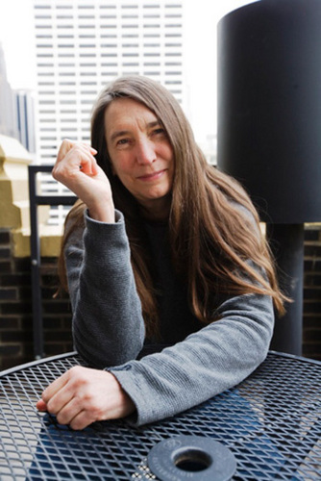
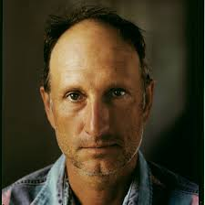
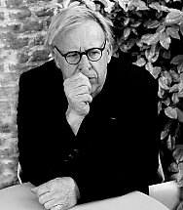
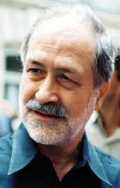
Bruce Nauman
Joseph Kosuth
Jenny Holzer
Others abstracts artists associated to Barbara Kruger: At USA there are Jenny Holzer, Bruce Nauman and Joseph Kosuth. In Germany there is Hans Haacke.
Hans Haacke

Slide 8
It’s finish, thank you for your attention !

