Slide 1
Edward Hopper (1882-1967)

Slide 2
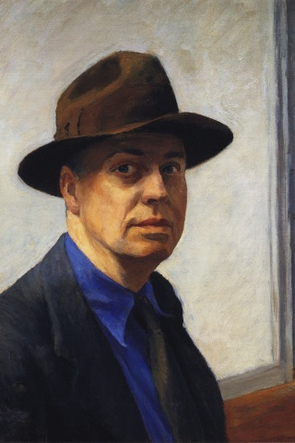
self-portrait

Slide 3
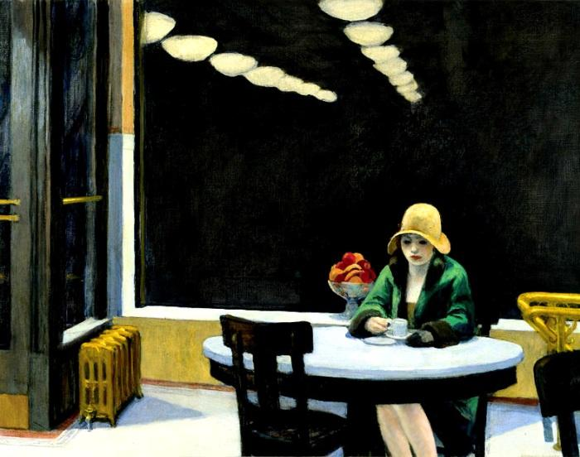

Slide 4
Dimension
oil on canvas
71,5cm*91,5cm
Iowa in USA

Slide 5
some works of Edward Hopper

Slide 6
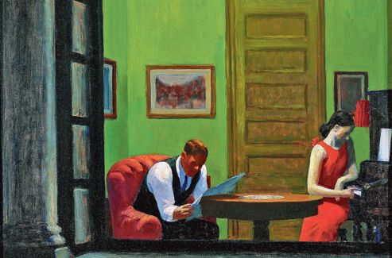

Slide 7
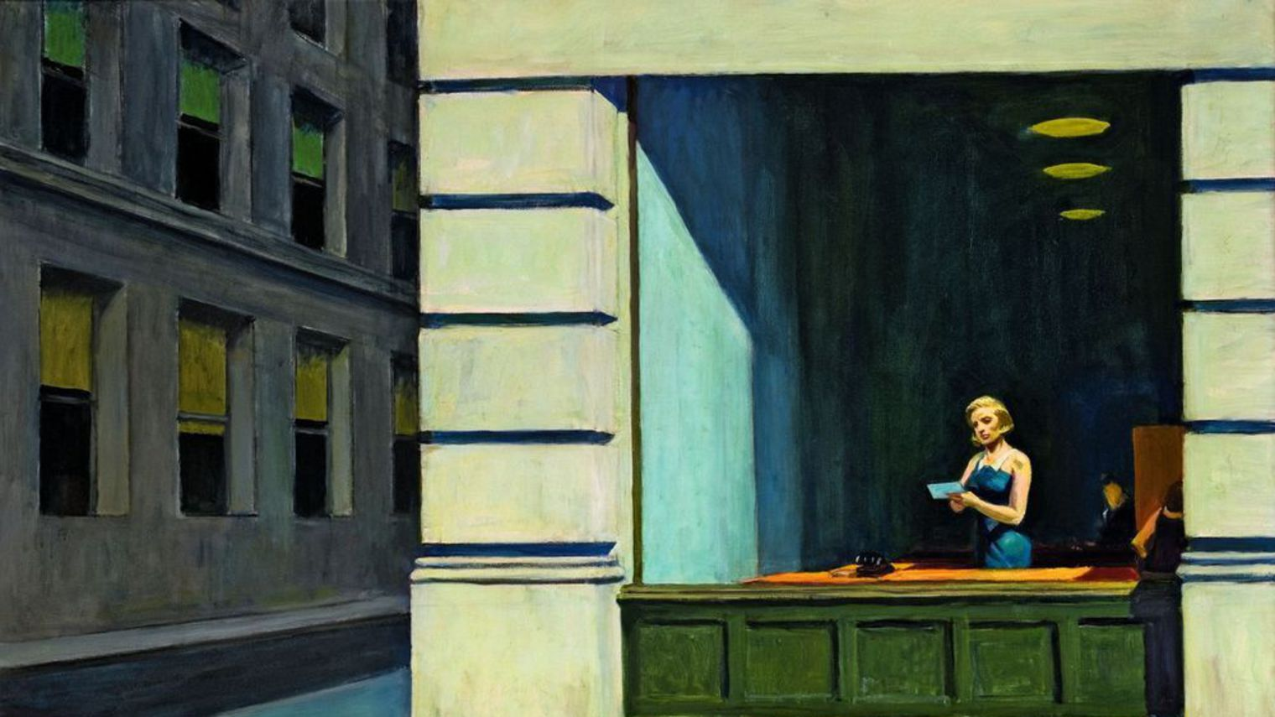

Slide 8
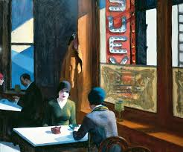
THE END

