Slide 1
Andy Warhol and the Pop art
- Andy Warhol
- His most expensive artwork
- Campbell’s soup cans

Slide 2
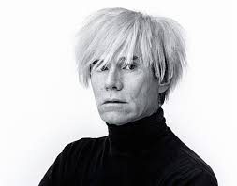
Andy Warhol
His real job: commercial illustrator
Know for his work as: Painter, film director, music producer and author.
Types of media used hand drawing, painting, printmaking, photography, silk screening, sculpture, film, and music.
pioneer in computer-generated art.
Gay man
ANDY WARHOL 06 AUGUST 1928 (PITTSBURG)-
22 FEBRUARY 1987 (NEW-YORK)
REAL NAME: ANDREW WARHOLA

Slide 3
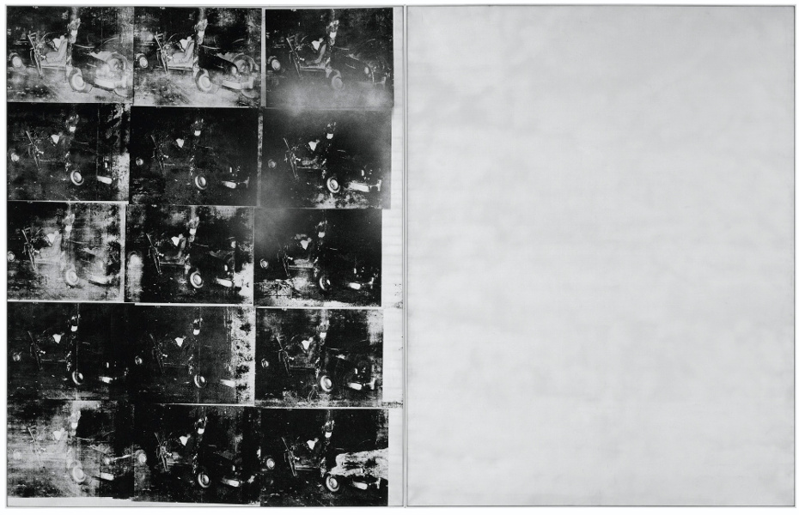
"Silver Car Crash (Double Disaster)"
The highest price ever paid for a Warhol painting is US$105 million for a 1963 canvas titled "Silver Car Crash (Double Disaster)"

Slide 4
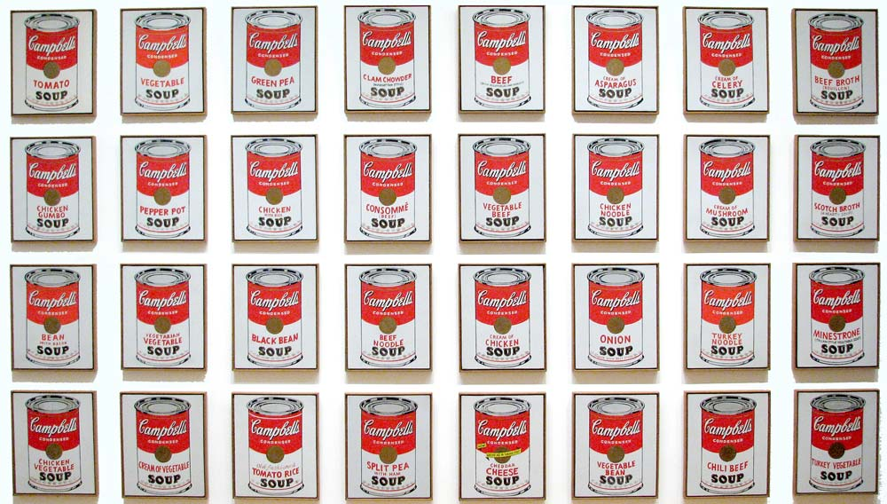
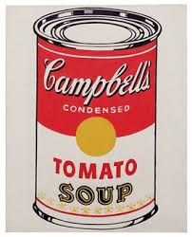
Campbell’s soup cans
Reflecting on his career, Warhol claimed that the Campbell’s Soup Can was his favourite work and that, "I should have just done the Campbell’s Soups and kept on doing them ... because everybody only does one painting anyway." Certainly, it is the signature image of the artist’s career and a key transitional work from his hand-painted to photo-transferred paintings
. Created during the year that Pop Art emerged as the major new artistic movement, two of his soup can paintings were included in the landmark Sidney Janis Gallery exhibition, ‘The New Realists’.

Slide 5
The Pop Art
Pop art is now most associated with the work of New York artists of the early 1960s such as Andy Warhol, Roy Lichtenstein, James Rosenquist, and Claes Oldenburg, but artists who drew on popular imagery were part of an international phenomenon in various cities from the mid-1950s onwards. Following the popularity of the Abstract Expressionists, Pop's reintroduction of identifiable imagery (drawn from mass media and popular culture) was a major shift for the direction of modernism. The subject matter became far from traditional "high art" themes of morality, mythology, and classic history; rather, Pop artists celebrated commonplace objects and people of everyday life, in this way seeking to elevate popular culture to the level of fine art. Perhaps owing to the incorporation of commercial images, Pop art has become one of the most recognizable styles of modern art.

